Slide 1
Scrum Escalation to Governance
Business Case : bottom-up

Slide 2
story
In 2007, the MAX PAYNE company , global leader in Legal SW has a problem :
it’s SW is too old and
maintenance costs are rising.
If they doesn't deliver a
new stable version they
lose
their client.
Their business

Slide 3
Step 1: the open door
Please help us do deliver a new version…
You are using Scrum for that… OK…no matter how, the important thing is that you deliver me a quick solution…

Slide 4
After 6 months
great, we have something to show

Slide 5
After 7 months
cool our main customer trust us and want this new stuff

Slide 6
After a Year
We must go live
Our backlog is too big we must scaling up the Team… how? Outsourcing?

Slide 7
Step 1

Slide 8
CONTEXT
How can we deliver faster?
We are going to ask these questions:
Growing the team size?
How can we get a second Scrum team?
Splitting the backlog? Or keeping one?
Adding external remote resources?

Slide 9
OBJECTIVES
First goal : deliver a first version of EagleEye (the Legal Software)
Second goal : increase overall velocity to deliver more, faster & with a high quality level

Slide 10
RELEASE 1.0
Objective: Secure the 1st release
Inputs: Backlog, Velocity, Bugs list, Release Plan, Definition of Done
Output: prioritized Backlog (including bugs), new Definition of Done, fine grained Release Plan
Process: attend Scrum ceremonies and support Product Owner
Make sure bugs can be fixed and when
Define the scope of this version
Review the Definition of Done of the team
Define a date when this release can be delivered
Review deployment strategy and tasks
Notes:
DoD Policies (Vision, Backlog, Sprint, Daily Scrum, Release)

Slide 11
SECOND GOAL
Increase overall velocity to deliver more, faster and with a high quality level

Slide 12
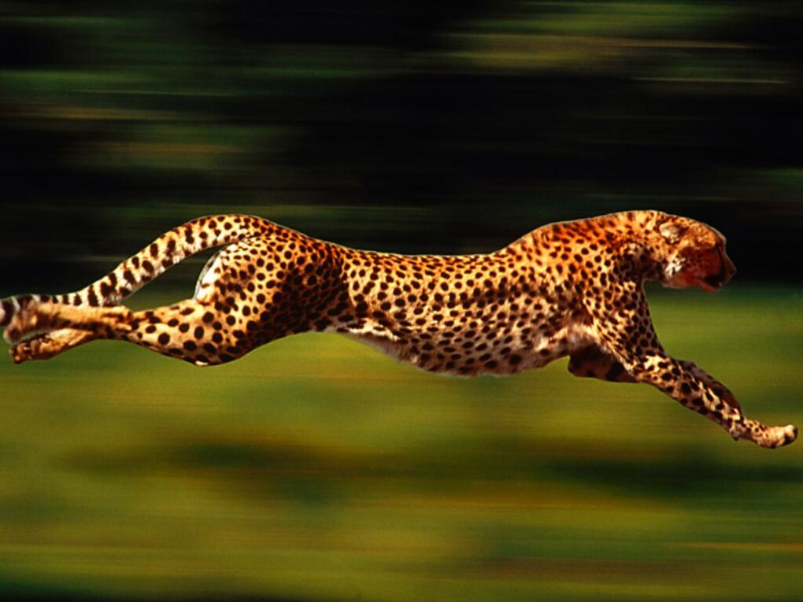
SOLUTIONS TO INCREASE VELOCITY
Create conditions of “hyper-productivity”
Add new team members

Slide 13
SOLUTIONS TO INCREASE VELOCITY
Create conditions of hyper-productivity
Inspect:
Assessment: Make sure the values of Scrum are shared by the team members => pass the “Nokia test”
Make sure the team fits the definition of a “Scrum team” (Scrum is the common language)
Adapt:
Optimize current team work
Optimize release and sprint rhythm
Fix the quality and reduce waste

Slide 14
DEFINITION OF A SCRUM TEAM
Reminder
Getting a Scrum team means :
1 Product
1 Vision
1 Roadmap
1 Backlog
1 Workspace
1 Product Owner
1 Scrum Master
1 Team (best size 5-7 people max)

Slide 15
NEW ORGANIZATION PROPOSAL
A new organization in two steps
Split the current team in two teams
Increase the number of Teams or/and the number of Team members

Slide 16
NEW ORGANIZATION PROPOSAL
Split the current team in two teams
Reasons :
The current team has reached the maximum of team members
To allow scaling the team further, we need to create a multiple-teams organization (“Scrum of Scrum”)
The first step is to split the current team and prepare the organization to integrate more team members
Benefits :
Splitting the current team in 2 teams is the first step to allow scalability
By reducing the number of people in each team, we improve interactions in the team and participation of all team members, two conditions that help reaching hyper-productivity

Slide 17
SPLITTING THE TEAM
1 TEAM => 2 TEAMS
2 BACKLOGS <= 1 BACKLOG
TEAM 1
PO : John
s/Product
Backlog 1
THEME 1
THEME 3
THEME 5
THEME 7
Current Team
PO : John
s/ Vision 1
Main Product Backlog
THEME 1
THEME 2
THEME 3
THEME 4
THEME 5
THEME 6
THEME 7
TEAM 2
PO : Paul
s/Product
Backlog 2
THEME 2
THEME 4
THEME 6
s/ Vision 2
Notes:
Dr Fichter = Business or CPO?
2 Views in 1 Backlog = pas OK

Slide 18
SPLITTING THE TEAM
Compose the two teams by balancing
Technical skills
Experience
Product knowledge
2 teams = 2 Product Owners
Find a second PO to work with one team
(ex: Paul, but needs dedicated time)
1 Backlog but each team works on distinct Themes
Manage priorities at the product level
Minimize dependencies
Integration and testing
Dedicate more resources for integration and testing

Slide 19
SCRUM CEREMONIES
Sprint Planning
Part 1: both teams together
Part 2: each team breaks down its sprint backlog
Daily Scrum
Each team holds its own daily Scrum
Sprint reviews
Part 1: each Team makes a demo
Part 2: Scrum of Scrum Review (Release)
Sprint retrospective
Both team do a joint retrospective
Scrum of Scrums (2 times/week)
CPO, PO, CSM, SM
Scaling Process

Slide 20
HOW ?
After Go Live for EagleEye
Estimation of the Product Backlog according to the new business priorities
Sizing the Backlog at Theme/Epic Level
Building a new customer-focused Roadmap
Coordinating expectations of EagleEye and of other customers (TITANIC, HULK, …)
Check out for Tools: sharing Code, Subversion, User Acceptance Testing, etc…

Slide 21
How it looks at Step 1
TEAM 1 “EagleEye”
PO : JOHN
SM: RINGO
Tech Lead PG
Comments:
at Step 1, we make the assumption that the PG Development Backlog is the Core Product Development Backlog of the EagleEye Application
to facilitate work progression, the main backlog is divided into two parts:
1 focused on PG
1 focused on New Features (e.g. L’Oreal, TOTAL, new comers…)
Core Product Backlog
CPO : JOHN
CSM: RINGO
Tech Lead “EagleEye”
Tech Lead “Custom”
TEAM 2 “New Features”
PO : PAUL
SM: GEORGE
Tech Lead “Custom”

Slide 22
How could it look at Step 2
Comments:
at Step 2,
PG development is hyperproductive and customer want to have new custom features
PG custom development start it’s own Scrum
“New Features”’s Backlog increase and we have to divide the “New Features” Backlog according to customer’s needs like “TITANIC” Backlog, “HULK Backlog”, etc…
“EagleEye” Custom Backlog
PO : JOHN
SM: RINGO
Tech Lead PG
EagleEye Product Backlog
CPO : JOHN
CSM: RINGO
Tech Lead “PG”
Tech Lead “Custom”
“Custom”
Backlog
PO : PAUL
SM: GEORGE
Tech Lead “Custom”
“TITANIC”
Backlog
Core
“HULK”
Backlog
Notes:
La séparation du “Core” est des autres applications permet:
Gérer les customisations sans interférer sur le coeur
d’identifier des add-on pouvant être commercialisables
gérer le cycle de vie du coeur et des modules indépendemment.

Slide 23
Metrics
Must have: clear metrics to help estimate added value, ROI and Delivery
Should have: a standard who’s been agile by nature
Could have: simple metrics to get understandable by all company levels (standard)
Won’t have: fragmented processes

Slide 24
We want to keep it simple
Objectives:
We want to measure the Outcome not the Outputs
We want to measure the Business Value
Process
Prioritization to maximize Business Value
Efficient shipping to minimize costs
Redistribution of resources when costs are too high or profits too low.

Slide 25
The Metrics within Scrum
Backlog Size
Velocity per Sprint/Iteration
Number of Sprints/Iterations to deliver the Project

Slide 26
What we want?
Integrating Cost and Schedule Performance
Financial forecasts based on actual cost :
Consumed Costs, Consuming Rate, Time Allocation, etc.
Unlike the velocity, the Actual Cost is the cumulative Team Costs

Slide 27
Using the AgileEVM approach
EVM
SCRUM
AgileEVM
Release dates are based on average velocity (storypoints)= estimate at complete (euros)
Assumption: the ratio(story points completed)/(total story points in a release) is a good measure for Actual Percent Complete

Slide 28
We want to measure
AC –Actual Cost
PV –Planned Value
EV –Earned Value
BAC –Budget at Complete
EAC –Estimate at Complete
CPI –Cost Performance Index
SPI –Schedule Performance Index

Slide 29
Calculation (example)

Slide 30
Calculation
Expected Percent Complete
Number of completed iteration
Number of planned iterations
Planned Value for a given iteration
Expected Percent Complete
Total Budget

Slide 31
Calculation
Actual Percent Complete
Total Number of Story Points completed
Total Number of Story Points planned
Earned Value
Actual Percent Complete
Total Budget

Slide 32
Inputs
Start Date
Budget At Complete
Planned Sprints
Sprint Lengths
Planned Release Story Points
+ Variables
Story Points Completed
Story Points Added
Actual Cost
Current Sprint

Slide 33
New Metrics: CPI
Cost Performance Index (CPI) gives measure of efficiency:
CPI = EV/AC
In the example, CPI = 35.000/65.000 = 0.53
CPI > 1 | CPI = 1 | CPI < 1
Under budget | On budget | Over budget
EV>AC | EV=AC | EV<AC
Estimate at completed = Total Budget / CPI
Here, EAC = 175.000 / 0.53 = 330.188 → we predict to be 47% over budget

Slide 34
New Metrics: SPI
Sheduled Performance Index (SPI), compares EV with PV:
SPI = EV/PV
In the example, CPI = 35.000/43.750 = 0.80
SPI > 1 | SPI = 1 | SPI < 1
Ahead on Schedule | On Schedule | Behind Schedule
EV>PV | EV=PV | EV<PV
Estimate Completion = Planned Iteration/ SPI
Here, planned Iteration is 4
Est. Compl. = 4 / 0.80 = 5 iterations

Slide 35
AgileEVM: Summary
Earned Value > Actual Costs | You spend less than expected | 
Actual Costs > Earned Value | You spend more than expected | 
Earned Value< Planned Value | You go over the schedule and deliver late | 
Earned Value>= Planned Value | Great, you're even ahead | 

Slide 36
Conclusion
Using simple Agile Metrics provides objective analysis to share with teams, management and customers.
The early warnings of AgileEVM validates changes to release plans and provides business with the opportunity to make priority trade-off decisions early in the project lifecycle.
Source: Tamara Sulaiman (InfoQ), Hubert Smits (rally SW)

Slide 37
Did we achieve the Governance Goals?
Goals | Status
IT / Business alignment | 
Business Value Creation | 
Portfolio Management | 
Resources Management | 
Performance Management | 
Risk Management | 
Standards | 
Maturity | 

Slide 38
What’s next
Company alignment:
Business change the BSC approach an wish to start Beyond Budgeting
Customer: Sales & Marketing and Customer Support are thinking to regroup their activity under a unique Customer Department to manage a better input for the Product Owner’s
IT is hyperproductive. The Teams identify new product opportunities and they spend now 10% of their time in New Product Research

Slide 39
This is an example how we…
Questions?

Slide 40
Thanks

